Slide 1
LESSON 4
BOOK CHAPTER 24
ELECTRIC POTENTIAL

Slide 2
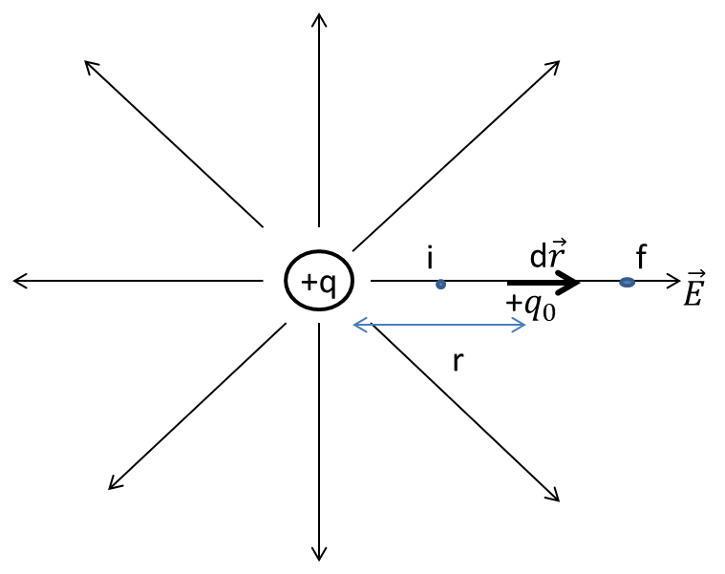
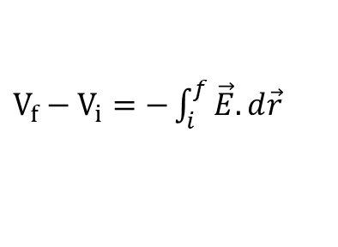

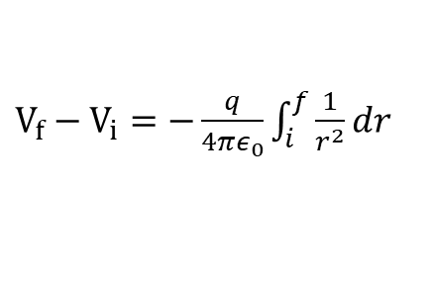
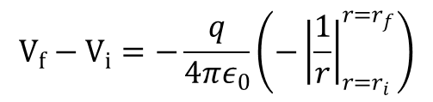
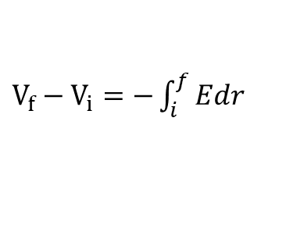

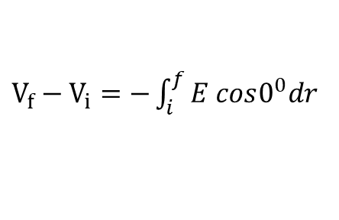
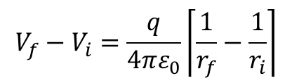
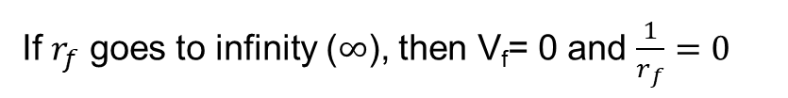
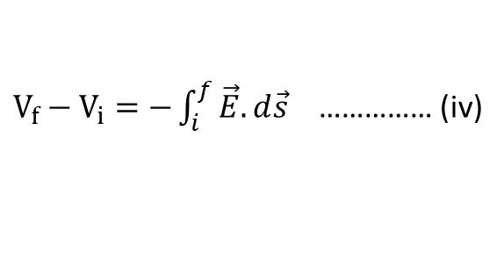

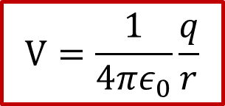
Potential Due to a Point Charge:
We have
$V_{f}−V_{i}=−\int_{i}^{f}{\vec{E}.d\vec{s}}$ …………… (iv)
$V_{f}−V_{i}=−\int_{i}^{f}{\vec{E}.d\vec{r}}$
[$here d\vec{s}$ =$d\vec{r}]$
$V_{f}−V_{i}=−\int_{i}^{f}{E cos0^{0}dr}$
$V_{f}−V_{i}=−\int_{i}^{f}{Edr}$
$V_{f}−V_{i}=−\frac{q}{4πε_{0}}\int_{i}^{f}{\frac{1}{r^{2}}dr}$
$$V_{f}−V_{i}=−\frac{q}{4πε_{0}}\left({−\left|\frac{1}{r}\right|}_{r=r_{i}}^{r=r_{f}}\right)$$
$$V_{f}−V_{i}=\frac{q}{4πε_{0}}\left\lceil \frac{1}{r_{f}}−\frac{1}{r_{i}}\right\rceil$$
If $r_{f}$ goes to infinity ($∞$), then V_{f}= 0 and $\frac{1}{r_{f}}=0$
$$0−V_{i}=\frac{q}{4πε_{0}}\left\lceil 0−\frac{1}{r_{i}}\right\rceil$$
Hence,
$$V=\frac{1}{4πε_{0}}\frac{q}{r}$$
Finally we get,
$$V_{i}=\frac{q}{4πε_{0}}\left\lceil \frac{1}{r_{i}}\right\rceil$$

Slide 3



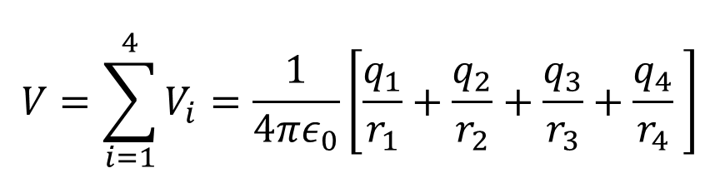

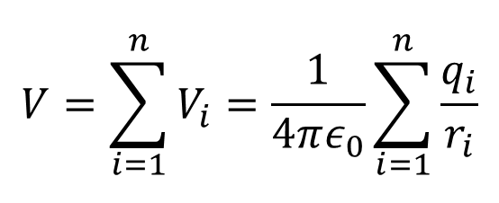




Potential Due to a Group of Point Charges:
General Formula:
$$q_{1}$$
$$q_{2}$$
$$V=\sum_{i=1}^{n}{V_{i}}=\frac{1}{4πε_{0}}\sum_{i=1}^{n}{\frac{q_{i}}{r_{i}}}$$
$$r_{1}$$
$$r_{2}$$
$$r_{4}$$
$$r_{3}$$
$$q_{3}$$
$$q_{4}$$
$$V=\sum_{i=1}^{4}{V_{i}}=\frac{1}{4πε_{0}}\left[\frac{q_{1}}{r_{1}}+\frac{q_{2}}{r_{2}}+\frac{q_{3}}{r_{3}}+\frac{q_{4}}{r_{4}} \right]$$
For an example:

Slide 4
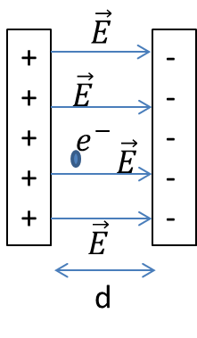
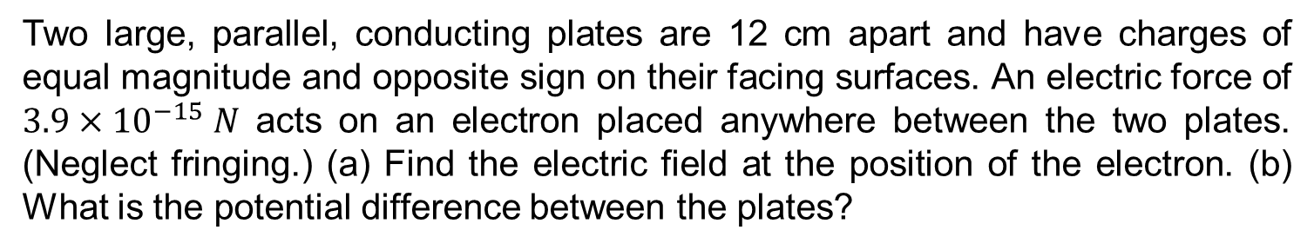


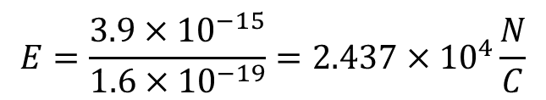


Problem: 4 (Book chapter 24)
Two large, parallel, conducting plates are 12 cm apart and have charges of equal magnitude and opposite sign on their facing surfaces. An electric force of $3.9×{10}^{−15} N$ acts on an electron placed anywhere between the two plates. (Neglect fringing.) (a) Find the electric field at the position of the electron. (b) What is the potential difference between the plates?
Answer:
Given
d= 12 cm = 0.12 m
$$\left|F\right|=3.9×{10}^{−15}N$$
$\left|e^{−}\right|=\left|q\right|=1.6×{10}^{−19}$C
$\left|E\right|=$?
(a)
We know
$$\left|F\right|=qE$$
$$E=\frac{3.9×{10}^{−15}}{{1.6×10}^{−19}}={2.437×10}^{4}\frac{N}{C}$$
(b)
The potential difference between the plates
$$\left|∆V\right|=Ed={(2.437×10}^{4})\left(0.12\right)={0.293×10}^{4} Volt$$

Slide 5
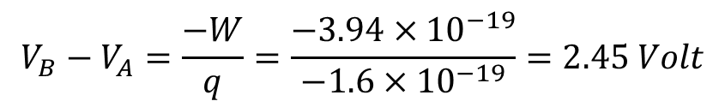
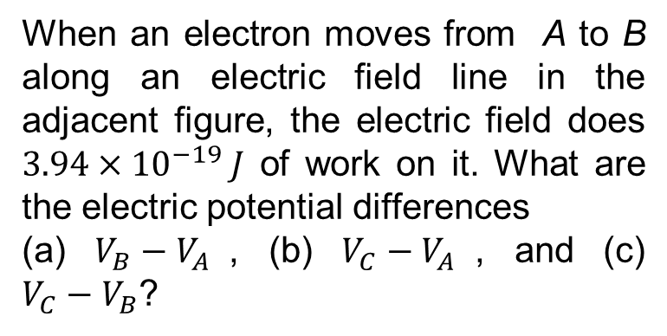


Problem: 6 (Book chapter 24)
When an electron moves from A to B along an electric field line in the adjacent figure, the electric field does $3.94×{10}^{−19} J$ of work on it. What are the electric potential differences
(a) $V_{B}−V_{A}$, (b) $V_{C}−V_{A}$, and (c) $V_{C}−V_{B}$?
Answer:
$$V_{B}−V_{A}=\frac{−W}{q}=\frac{{−3.94×10}^{−19}}{−{1.6×10}^{−19}}=2.45 Volt$$
(a)
(b)
$$V_{c}−V_{A}=2.45 Volt$$
[Because points B and C are
on the same equipotential surface]
(c)
$$V_{c}−V_{B}=0 Volt$$

Slide 6
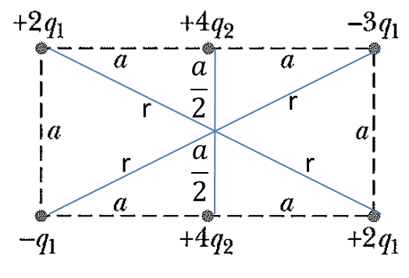
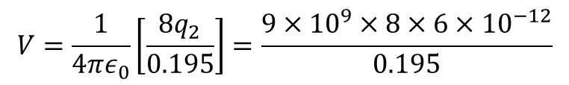

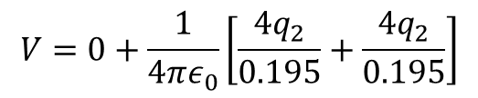
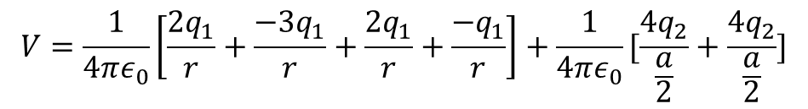
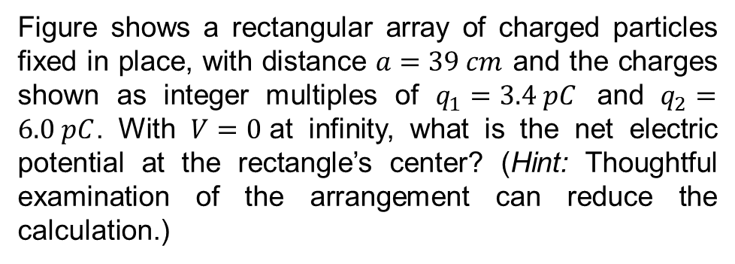



Problem: 16 (Book chapter 24)
Figure shows a rectangular array of charged particles fixed in place, with distance $a=39 cm$ and the charges shown as integer multiples of $q_{1}=3.4 pC$ and $q_{2}=6.0 pC$. With $V=0$at infinity, what is the net electric potential at the rectangle’s center? (Hint: Thoughtful examination of the arrangement can reduce the calculation.)
Answer:
Given
$$a=39 cm=0.39 m$$
$$q_{1}=3.40 pC=3.4×{10}^{−12} C$$
The net potential at the rectangle center is
$$q_{2}=6.0 pC=6.0×{10}^{−12} C$$
$$V=\frac{1}{4πε_{0}}\left[\frac{2q_{1}}{r}+\frac{{−3q}_{1}}{r}+\frac{{2q}_{1}}{r}+\frac{{−q}_{1}}{r}\right]+\frac{1}{4πε_{0}}[\frac{{4q}_{2}}{\frac{a}{2}}+\frac{{4q}_{2}}{\frac{a}{2}}]$$
$$V=0+\frac{1}{4πε_{0}}\left[\frac{{4q}_{2}}{0.195}+\frac{{4q}_{2}}{0.195}\right]$$
$$V=\frac{1}{4πε_{0}}\left[\frac{{8q}_{2}}{0.195}\right]=\frac{{9×10}^{9}×8×6×{10}^{−12}}{0.195}$$
$V=$2.215 Volt

Slide 7

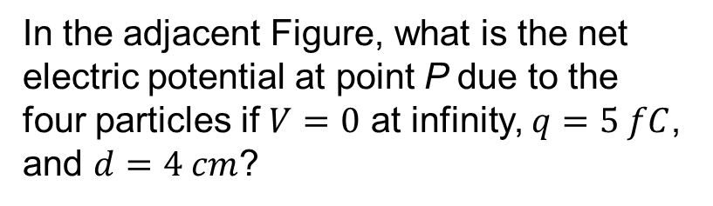

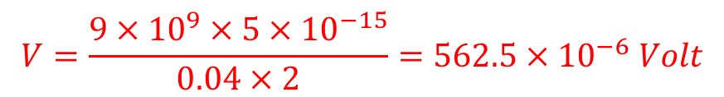
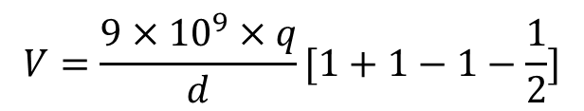
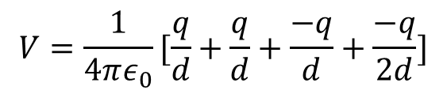
Problem: 17 (Book chapter 24)
In the adjacent Figure, what is the net electric potential at point P due to the four particles if $V=0$ at infinity, $q=5 fC$, and $d=4 cm$?
Answer:
Given
$$q=5 fC={5×10}^{−15} C$$
and
$$d=4 cm=0.04 m$$
The net electric potential at the point P is
$$V=\frac{1}{4πε_{0}}[\frac{q}{d}+\frac{q}{d}+\frac{−q}{d}+\frac{−q}{2d}]$$
$$V=\frac{{9×10}^{9}×q}{d}[1+1−1−\frac{1}{2}]$$
$$V=\frac{{9×10}^{9}×5×{10}^{−15}}{0.04×2}=562.5×{10}^{−6} Volt$$

Slide 8
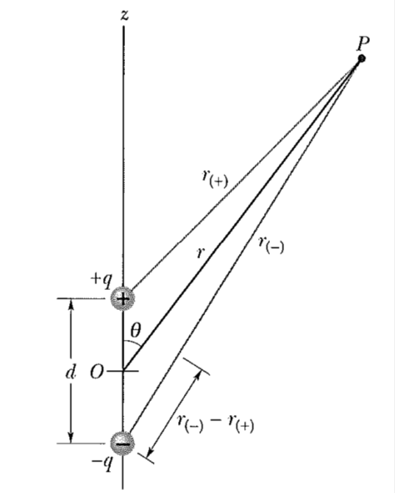
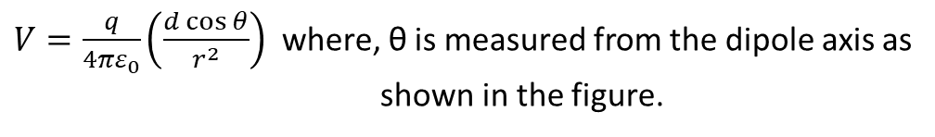

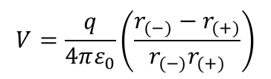

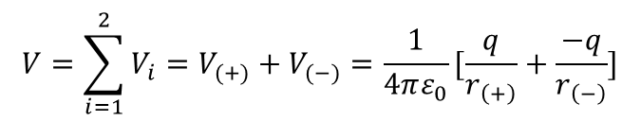
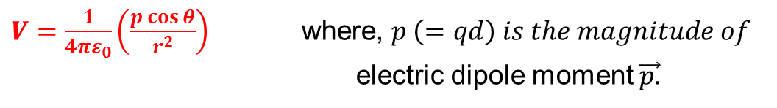
Potential Due to an Electric Dipole:
The net potential at P is given by
$$V=\sum_{i=1}^{2}{V_{i}=V_{(+)}+V_{(−)}=\frac{1}{4πε_{0}}[\frac{q}{r_{\left(+\right)}}+\frac{−q}{r_{\left(−\right)}}]}$$
$$V=\frac{q}{4πε_{0}}\left(\frac{r_{(−)}−r_{(+)}}{r_{(−)}r_{(+)}}\right)$$
For dipoles, usually, r $≫d$, where d is the distance between the charges.
Under the above condition, from the figure we can write
$$r_{(−)}−r_{\left(+\right)}=dcosθ and r_{\left(−\right)}r_{\left(+\right)}≈ r^{2}$$
Substituting these values in the above equation, we get
$V=\frac{q}{4πε_{0}}\left(\frac{d\cos{θ}}{r^{2}}\right)$ where, θ is measured from the dipole axis as
shown in the figure.
$V=\frac{1}{4πε_{0}}\left(\frac{p\cos{θ}}{r^{2}}\right)$ where, $p \left(=qd\right) is the magnitude of$
electric dipole moment $\vec{p.}$
The vector $\vec{p}$ is directed along the dipole axis, from the negative to the positive charge.

Slide 9
THANK YOU

